Slide 1
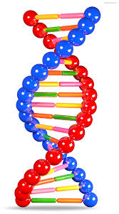

Evolutionary Algorithms
Dr. Bo Yuan

Slide 2
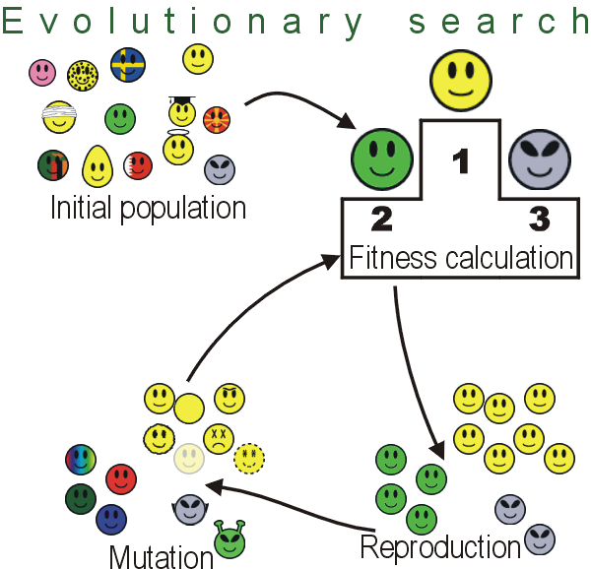
Overview
Global Optimization
Genetic Algorithms
Genetic Programming
Evolvable Things

Slide 3
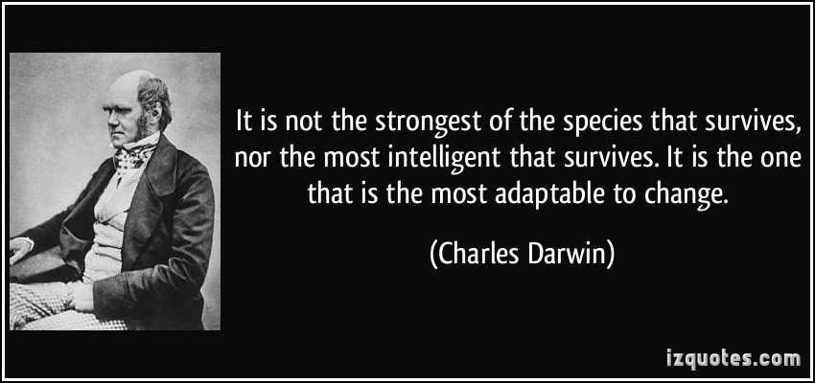

Slide 4

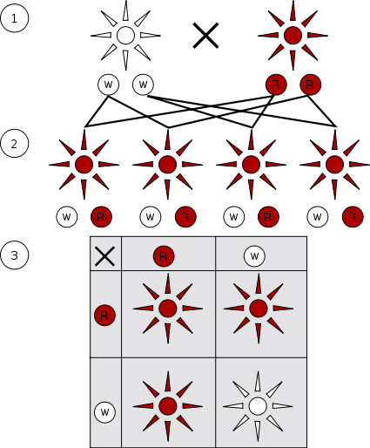
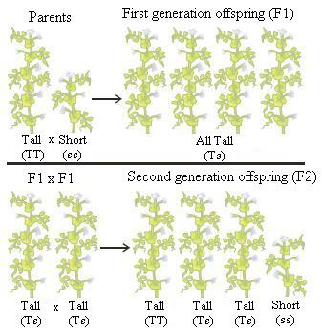

Slide 5

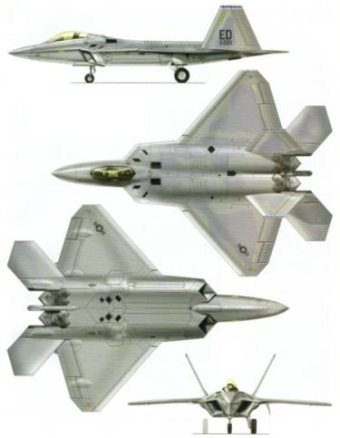
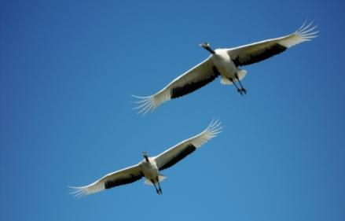
Learning from Nature

Slide 6
Motivation of EAs
What can EAs do for us?
Optimization
Help people understand the evolution in nature.
What is optimization?
The process of searching for the optimal solution from a set of candidates to the problem of interest based on certain performance criteria.
Accomplish a predefined task to the highest standard.
Job Shop Problem
Produce maximum yields given limited resources.
Investment Strategy

Slide 7
Key Concepts
Population-Based Stochastic Optimization Methods
Inherently Parallel
A Good Example of Bionics in Engineering
Survival of the Fittest
Chromosome, Crossover, Mutation
Metaheuristics
Bio-/Nature Inspired Computing

Slide 8
The Big Picture
Evolutionary Search
Evaluate
Select
Crossover
Mutate
Coding
Objective Function
Domain Knowledge
Problem

Slide 9

EA Family
GA: Genetic Algorithm
GP: Genetic Programming
ES: Evolution Strategies
EP: Evolutionary Programming
EDA: Estimation of Distribution Algorithm
PSO: Particle Swarm Optimization
ACO: Ant Colony Optimization
DE: Differential Evolution

Slide 10
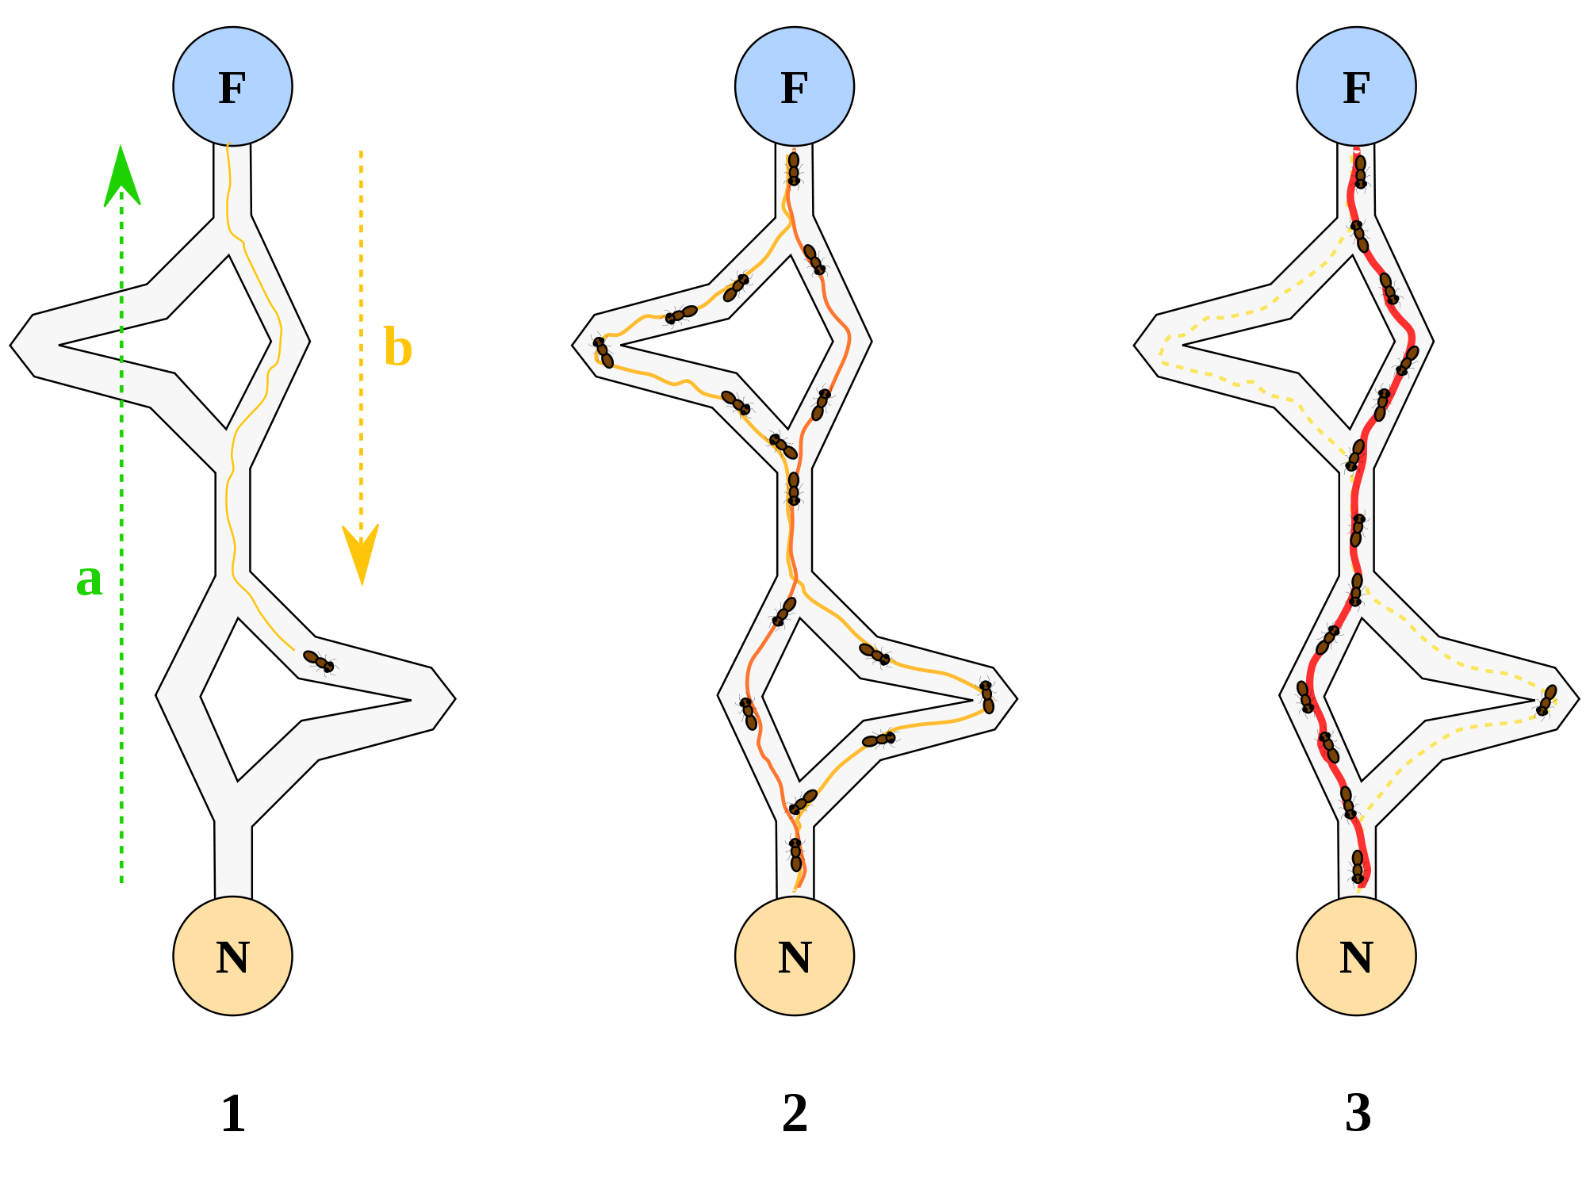


Slide 11
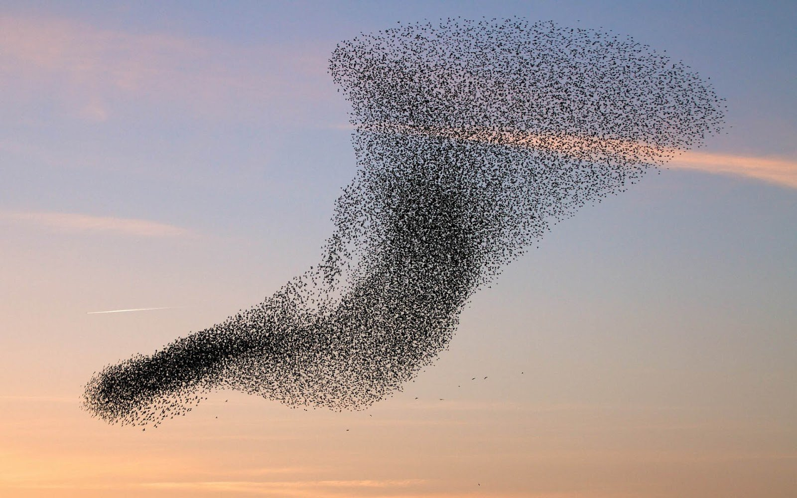

Slide 12


Slide 13
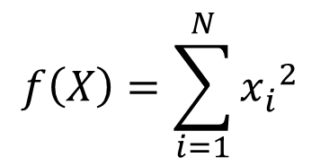
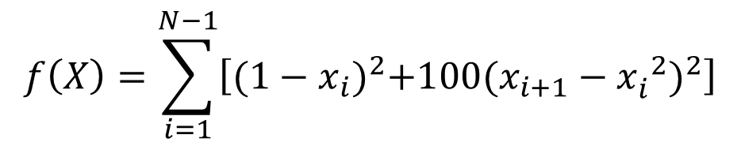
Objective Function
x₁
x_{n}
f
Output
$$f\left(X\right)=\sum_{i=1}^{N}{{x_{i}^{}}^{2}}$$
$$f\left(X\right)=\sum_{i=1}^{N−1}{\left[{(1−x_{i})}^{2}+100{(x_{i+1}−{x_{i}^{}}^{2})}^{2}\right]}$$

Slide 14
Portfolio Optimization

Slide 15
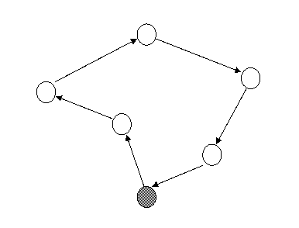
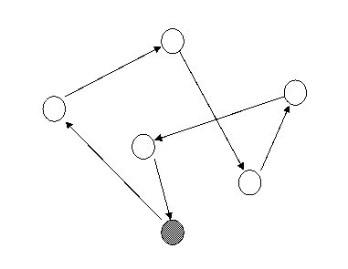
Travelling Salesman Problem
Totally 20!=2,432,902,008,176,640,000 different routes for a 20-city problem.

Slide 16






Knapsack Problem
$

Slide 17


Bin Packing Problem

Slide 18
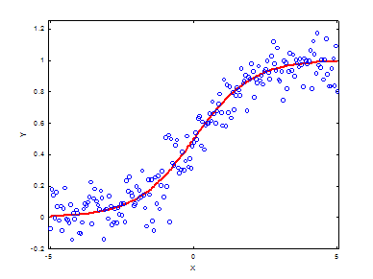
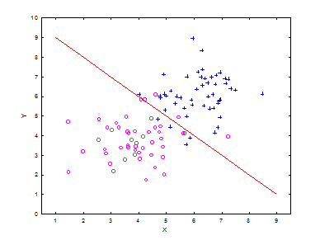
Machine Learning Problems
Regression
Classification

Slide 19
Local Optima
f
f
f
0
X
0
X
0
X
Easy
Challenging
Average

Slide 20
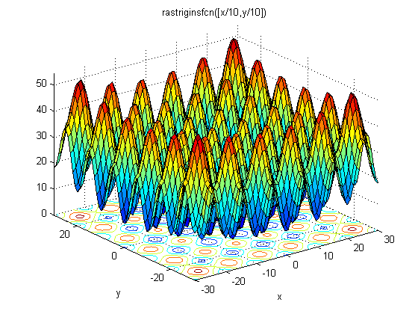
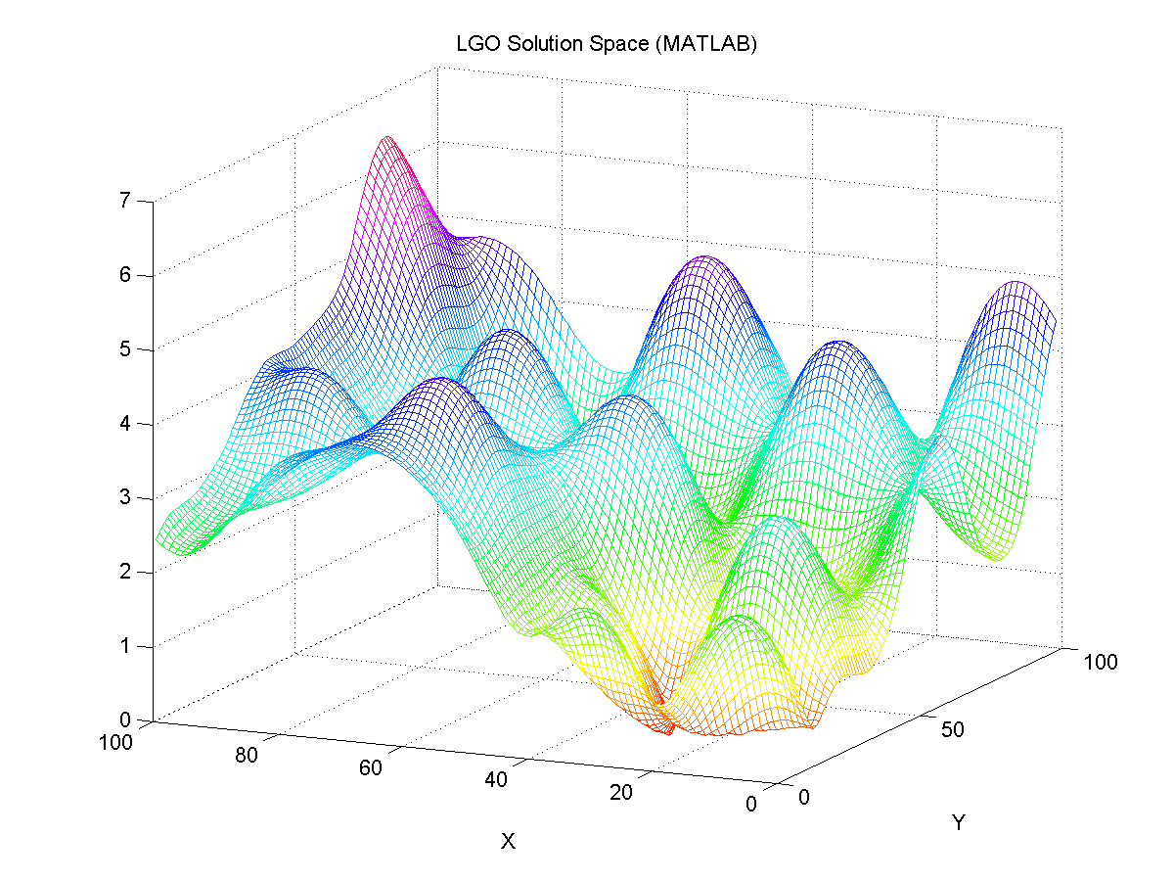
Local Optima + Dimensionality
The size of the search space grows exponentially!

Slide 21

The Bad News
Many interesting optimization problems are not trivial.
The optimal solution cannot always be found in polynomial time.
Feature Selection Problem
Start with N features.
Redundant/Irrelevant/Noisy
Select a subset of features.
Objective: Highest Accuracy
How challenging is this task?

Slide 22
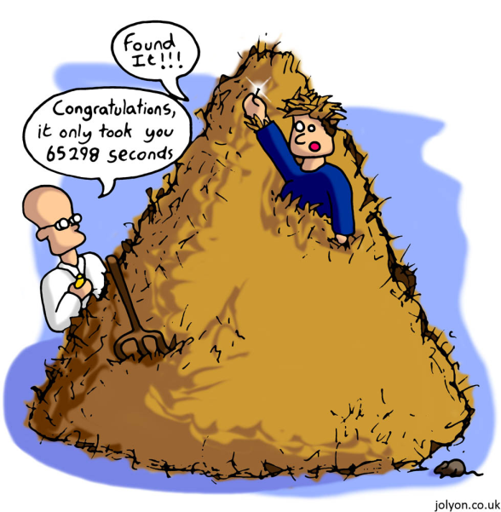
The Bad News
Given 32 features (N=32)
1: selected feature; 0: unselected feature
The optimal solution may look like:
0010 1100 0000 0100 0000 0000 0000 0001
{3, 5, 6, 14, 32}
However, there are 2³²-1 combinations in total.
1 in 4,294,967,295 chance
Needle-in-a-haystack situation
Unless you are extremely lucky….
The Limitation of Computation

Slide 23

FLOPS
FLoating point OPerations per Second
GFLOPS (gigaFLOPS): 10⁹ (每秒10亿次运算)
TFLOPS (teraFLOPS): 10¹² (每秒1万亿次运算)
PFLOPS (petaFLOPS): 10¹⁵ (每秒1千万亿次运算)
Intel Core i7 980 XE: ~100 GFLOPS
Bremermann's Limit
c²/h=9×10¹⁶/6.62606896×10⁻³⁴ ≈1.36×10⁵⁰ bits·s⁻¹·kg⁻¹
Is it fast enough?
~6×10²⁴ KG

Slide 25



How to solve it?
Multimodal
Local Search
f
X
0

Slide 26
How to solve it?
Dependences
Divide-and-Conquer
Y
Z=f (X, Y)
0
X

Slide 27

Solution: Parallel Search
Conduct searching in different areas simultaneously.
Population Based
Avoid unfortunate starting positions.
Employ heuristic methods to effectively explore the space.
Focus on promising areas.
Also keep an eye on other regions.
More than random restart strategies.
This is where EAs come into play!

Slide 28

Publications
Top Journals:
IEEE Transactions on Evolutionary Computation
Evolutionary Computation Journal (MIT Press)
Major Conferences:
IEEE Congress on Evolutionary Computation (CEC)
Genetic and Evolutionary Computation Conference (GECCO)
Parallel Problem Solving from Nature (PPSN)

Slide 29




People
Prof. Xin Yao
The University of Birmingham
www.cercia.ac.uk
Former EiC: IEEE Transactions on Evolutionary Computation
Former President of the IEEE Computational Intelligence Society
Dr. David Fogel
Natural Selection Inc.
www.natural-selection.com
Blondie24: Playing at the Edge of AI
Prof. Zbigniew Michalewicz
University of Adelaide
cs.adelaide.edu.au/~zbyszek
How to Solve It: Modern Heuristics

Slide 30
People
Prof. David E. Goldberg
University of Illinois at Urbana-Champaign
scholar.google.com/citations?user=BUzKxsoAAAAJ
Genetic Algorithms in Search, Optimization and Machine Learning (1989)
Prof. Kenneth A. De Jong
George Mason University
www.cs.gmu.edu/~eclab
De Jong Test Suite (PhD Thesis, 1975)
Evolutionary Computation: A Unified Approach (MIT Press, 2006)
Prof. Melanie Mitchell
Portland State University
web.cecs.pdx.edu/~mm
An Introduction to Genetic Algorithms (MIT Press, 1996)

Slide 31
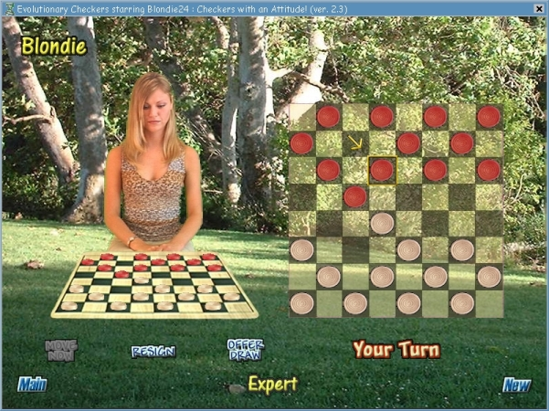
Blondie24

Slide 32
Review
Evolutionary Algorithms
Key Concepts
EA Family
Where to find related information?
What is optimization?
Typical Optimization Problems
What makes a problem difficult to optimize?

Slide 34
A Gentle Introduction to
Genetic Algorithms

Slide 35
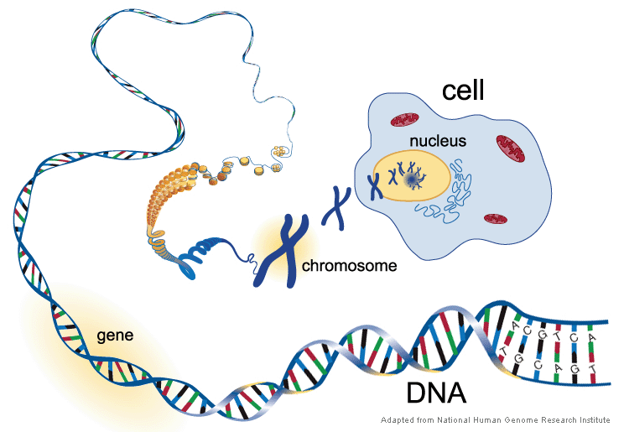
Biology Background

Slide 36
Biology Background
Gene
A working subunit of DNA
Gene Trait
For example: colour of eyes
Allele
Possible settings for a trait (e.g., Blown, Gray and Blue)
Genotype
The actual genes carried by an individual
Phenotype
The physical characteristics into which genes are translated

Slide 37
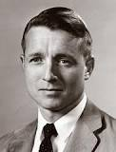
Genetic Algorithms
John Holland
Adaptation in Natural and Artificial Systems, 1975
Inspired by and (loosely) based on Darwin’s Theory
Chromosome
Crossover
Mutation
Selection (Survival of the Fittest)
Basic Ideas
Each solution to the problem is represented as a chromosome.
The initial solutions may be randomly generated.
Solutions are evolved during generations.
Improved gradually based on the principle of natural evolution.

Slide 38
Basic Components
Representation
How to encode the parameters of the problem?
Binary Problems
10001 00111 11001 …..
Continuous Problems
0.8 1.2 -0.3 2.1 …..
Genetic Operators
Crossover
Exchange genetic materials between two chromosomes.
Mutation:
Randomly modify gene values at selected locations.
Selection Strategy
Which chromosomes should be involved in reproduction?
Which offspring should be able to survive?

Slide 39
Representation
Individual (Chromosome)
A vector that represents a specific solution to the problem.
Each element on the vector corresponds to a certain variable/parameter.
Population
A set of individuals
GAs maintain and evolve a population of individuals.
Parallel Search → Global Optimization
Offspring
New individuals generated via genetic operators
Hopefully contain better solutions.
Encoding
Binary vs. Gray
How to encode TSP problems?

Slide 40


Binary vs. Gray
Decimal | Binary | Gray
0 | 000 | 000
1 | 001 | 001
2 | 010 | 011
3 | 011 | 010
4 | 100 | 110
5 | 101 | 111
6 | 110 | 101
7 | 111 | 100
Rotary Encoder

Slide 41

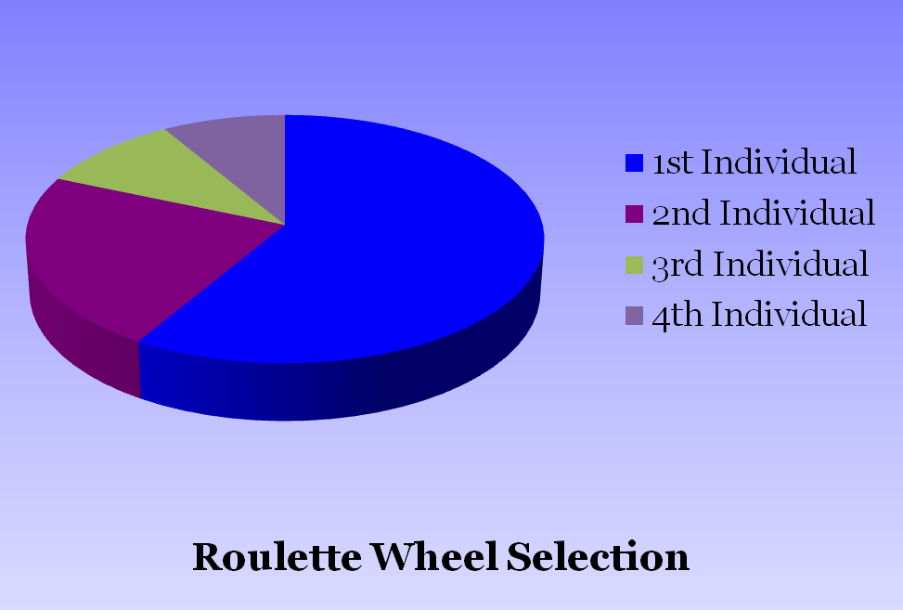
Selection I
Values
1 | 8.2
2 | 3.2
3 | 1.4
4 | 1.2
Negative Values?

Slide 42
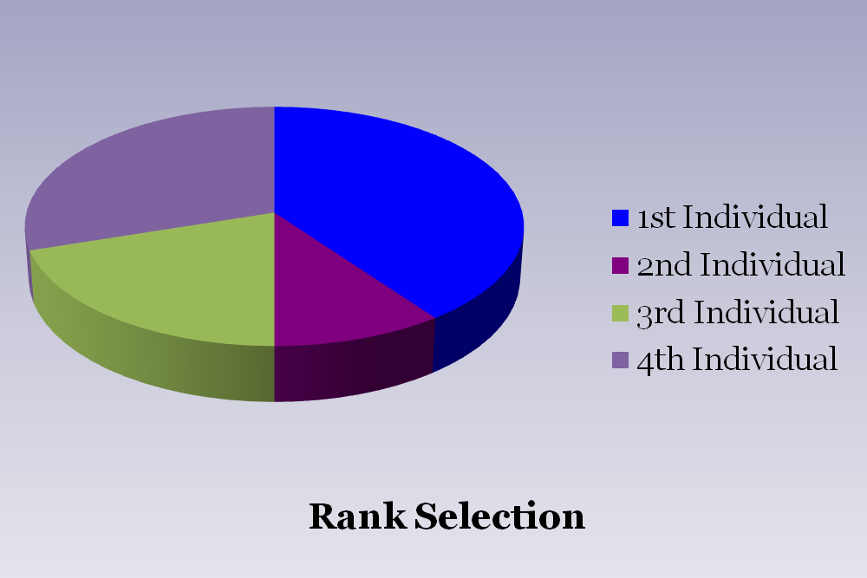
Selection II
Values
Rank
1 | 8.2 | 4
2 | -3.2 | 1
3 | 1.4 | 2
4 | -1.2 | 3

Slide 43
Selection III
FIGHT!
Tournament Size?
Tournament Selection

Slide 44
Selection IV
Elitism
Offspring are not necessarily better than their parents.
The best individual in the current population may be lost.
Destroyed by crossover & mutation
Copy the best individual to the next generation.
Improve the stability and performance of GAs.
Offspring Selection
Usually the old population is replaced by the offspring.
Are their any other options?
(μ, λ) Strategy
(μ+λ) Strategy

Slide 46
Crossover I
Parent 1
Parent 2
Offspring 1
Offspring 2
One Point Crossover

Slide 47
Crossover II
Parent 1
Parent 2
Offspring 1
Offspring 2
Two Point Crossover

Slide 48
Crossover III
Parent 1
Parent 2
Offspring
Uniform Crossover

Slide 49
Is It Always Easy?
Parent 1
1 | 2 | 3 | 4 | 5 | 6 | 7 | 8 | 9
3 | 1 | 2 | 8 | 4 | 9 | 5 | 7 | 6
Parent 2
Offspring 1
1 | 2 | 3 | 4 | 4 | 9 | 5 | 7 | 6
3 | 1 | 2 | 8 | 5 | 6 | 7 | 8 | 9
Offspring 2
Crossover of Two Individuals for TSP

Slide 50
Mutation
Parent
Offspring
Mutation vs. Crossover
Mutation is mainly used to maintain the genetic diversity.

Slide 51

Population Diversity
Population
 | 0
 | 1
 | 0
 | 1
 | 1
 | 0
 | 0
1
1
1
1
1
1
1
k^{th} dimension
Loss of genetic diversity → Premature Convergence

Slide 52
Selection vs. Crossover vs. Mutation
Selection
Bias the search effort towards promising individuals.
Loss of genetic diversity
Crossover
Create better individuals by combining genes from good individuals.
Building Block Hypothesis
Major search power of GAs
No effect on genetic diversity
Mutation
Increase genetic diversity.
Force the algorithm to search areas other than the current focus.
Exploration vs. Exploitation

Slide 53
The Complete Picture
Population
Selection
k^{th} individual
Crossover
Mutation
Offspring

Slide 54
GA Framework
Initialization: Generate a random population P of M individuals
Evaluation: Evaluate the fitness f(x) of each individual
Repeat until the stopping criteria are met:
Reproduction: Repeat the following steps until all offspring are generated
Parent Selection: Select two parents from P
Crossover: Apply crossover on the parents with probability P_{c}
Mutation: Apply mutation on offspring with probability P_{m}
Evaluation: Evaluate the newly generated offspring
Offspring Selection: Create a new population from offspring and P
Output: Return the best individual found

Slide 55

Parameters
Population Size
Too big: Slow convergence rate
Too small: Premature convergence
Crossover Rate
Recommended value: 0.8
Mutation Rate
Recommended value: 1/L
Too big: Disrupt the evolution process
Too small: Not enough to maintain diversity
Selection Strategy
Tournament Selection
Truncation Selection (Select top T individuals)
Need to be careful about the selection pressure.

Slide 56

A Few More Words
No Free Lunch!
So called “optimal” parameter values do not exist!
Vary from problems to problems.
Need some trials to find suitable parameter values.
Randomness
Inherently stochastic algorithms
Independent trials are needed for performance evaluation.
Why does it work?
Easy to understand & implement (No maths required!)
Very difficult to analyse mathematically.
Converge to global optimum with probability 1 (infinite population).
Schema Theorem

Slide 58
Feature Selection
Select a subset of features from the original features.
Dimension Reduction
Remove irrelevant features
Motivation
Less challenging in training
Faster running time
Higher accuracy
Better understanding
Approaches
Filter Method: Does not consider classification error.
Wrapper Method: Does consider classification error.

Slide 59
GAs & Feature Selection
Representation
Binary strings
Fitness Function
Classification errors (KNN, SVM, ANN etc.)
Evolve a population of candidate subset of features.
Major Issues
The number of candidate features (Curse of Dimensionality)
Computational cost
Reading Materials
“A Survey of Genetic Feature Selection in Mining Issues” CEC’99

Slide 60
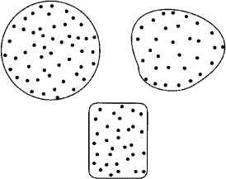
Clustering
Definition
The process of partitioning a group of data into K groups based on certain similarity metric.
Unsupervised Learning (Unlabeled Data)

Slide 61
K-Means
1. Choose K points as the initial cluster centres.
2. Assign each point to the cluster with the closest centre.
3. Recalculate the positions of the K centres.
4. Repeat Steps 2 and 3 until the centres no longer move.
Major Issue: Sensitive to the initial K centres!
Could get stuck at suboptimal solutions!

Slide 62
GAs & Clustering
Use GAs to final an optimal set of cluster centres!
Representation
A string of K centres
Length: K·D (D is the data dimensionality)
Fitness Evaluation
Assign each data to the nearest cluster.
Calculate the new cluster centres.
Update the old cluster centres (individuals).
The quality of clustering is measured by:
Reading Materials
“Genetic Algorithm-Based Clustering Technique”
Pattern Recognition , vol. 33(9), 2000

Slide 63
Open Questions
Parameter Control
Parameter Tuning
Heuristics for changing parameter values on the run
Constraint Handling
All real-world problems have constraints.
Box-Bounded Constraints
Linear Constrains
Multi-Objective Optimization
Objectives may be contradicting.
Model Complexity vs. Prediction Accuracy
Profit vs. Risk

Slide 64
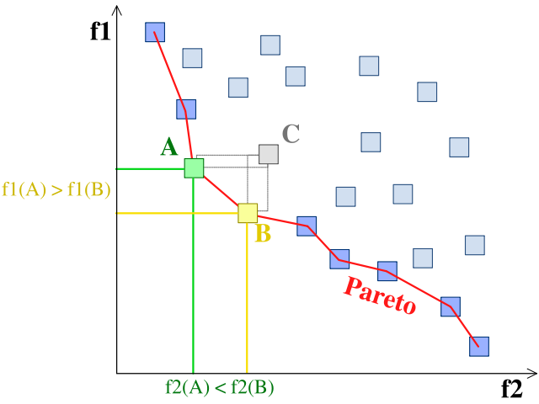
Pareto Front

Slide 65
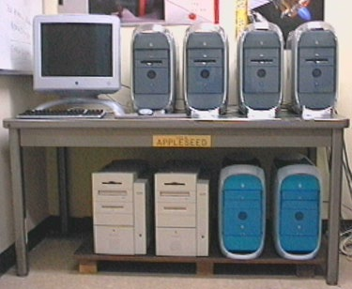

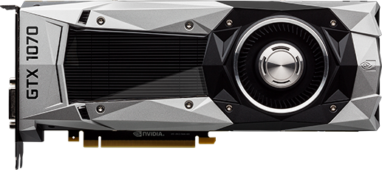
Parallel Computing
There are many parallel components in EAs …

Slide 66


Review
Basic Concept of GAs
Major Components
Crossover
Mutation
Selection
Representation
GA Framework
Practical Issues
Applications in Feature Selection & Clustering
EC Digest: https://listserv.gmu.edu/cgi-bin/wa?A0=ec-digest-l

Slide 68
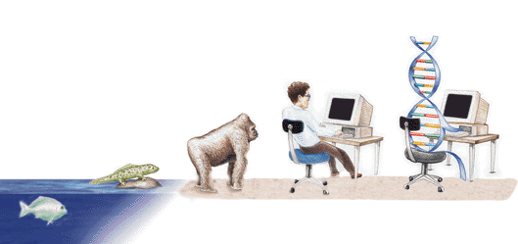
Genetic Programming and evolvable Things

Slide 69
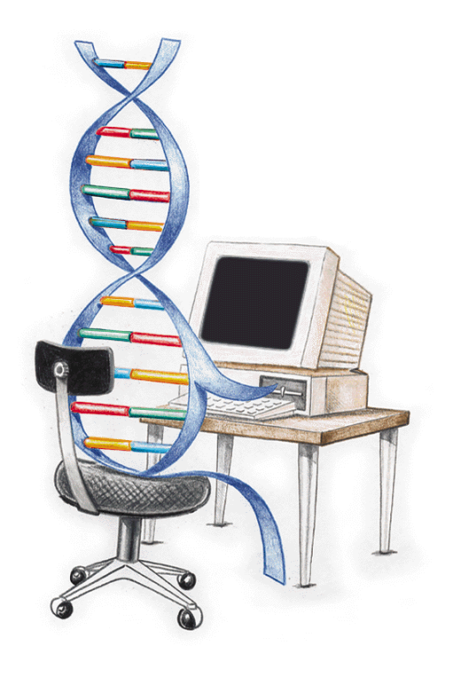
GA vs. GP
GP is a branch of GAs.
Crossover/Mutation/Selection
Representation
GA: Strings of numbers (0/1)
GP: Computer programs in tree structure (LISP)
Output
GA: A set of parameter values optimizing the fitness function
GP: A computer program (Yes, a computer program!)
John Koza
Genetic Programming: On the Programming of Computers by Means of Natural Selection. Cambridge, MIT Press, 1992.
www.genetic-programming.org

Slide 70
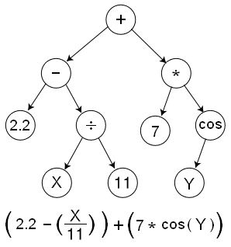
Functions & Terminals
Important Concepts in GP
Building Block of Computer Programs
Terminal Set
Variables: x, y, z …
Constants: 1, 2, 3,…
Function Set
+, -, *, /
Problem specific functions

Slide 71
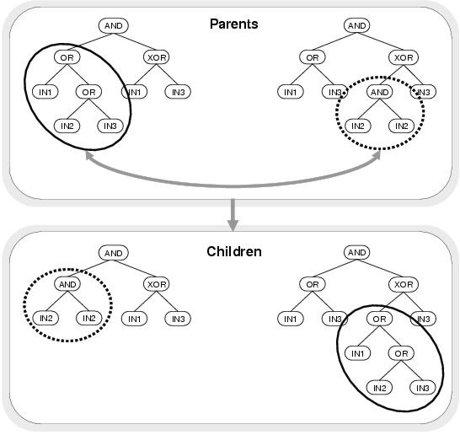

Crossover

Slide 72




Crossover
$$÷$$
$$÷$$
-
*
-
*
b
2
a
b
2
a
-
-
*
*
*
*
b
b
*
*
b
b
*
*
2
2
a
c
2
2
a
c
Identical Parents

Slide 73

Crossover
$$÷$$
$$÷$$
-
*
-
*
b
*
*
b
2
a
-
2
2
a
c
-
*
*
*
*
b
b
*
*
b
b
2
a
2
2
a
c
Identical Parents → Different Children

Slide 74




Mutation
$$÷$$
$$÷$$
-
*
-
*
b
2
a
b
a
a
-
+
*
*
*
*
b
b
*
*
b
b
*
*
2
2
a
c
2
2
a
c

Slide 75
An Example of GP
Symbolic Regression
Given a set of data points (x, y)
Evolve a quadratic polynomial
Approximation of y given x
Find the underlying function y=f(x).
Fitness Evaluation
Absolute values of the differences (errors)
∑|y-y ′|

Slide 76
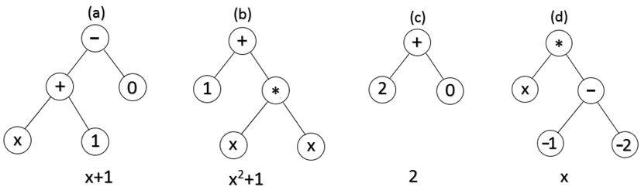
Generation 0
T = {X, R}
F = {+, -, *, %}

Slide 77
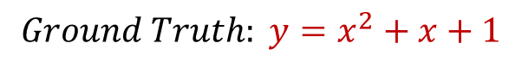
Generation 0
(a)
(b)
(c)
(d)
0.67
1.0
1.70
2.67
Fitness Values
$$Ground Truth: y=x^{2}+x+1$$

Slide 78
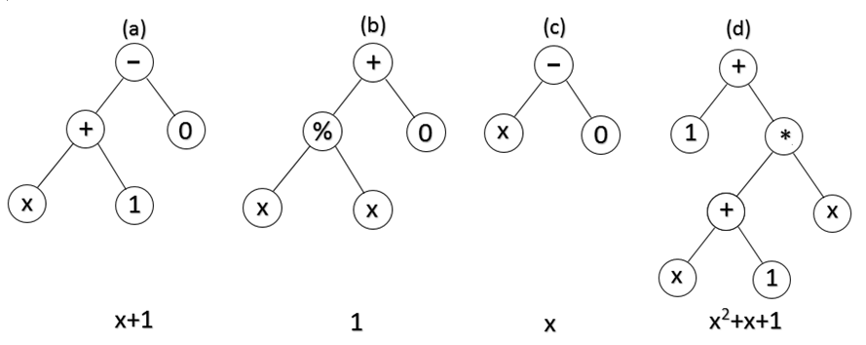
Generation X
Optimal Solution

Slide 79

Review
Tree-Structured Computer Programs
Flexible in length
Problem specific functions and terminals
Applications
Regression problem
Control problem
Classification
Genetic Programming and Evolvable Machines Journal
Evolvable Hardware
Circuits that change their architecture and behavior dynamically and autonomously by interacting with its environment.

Slide 81
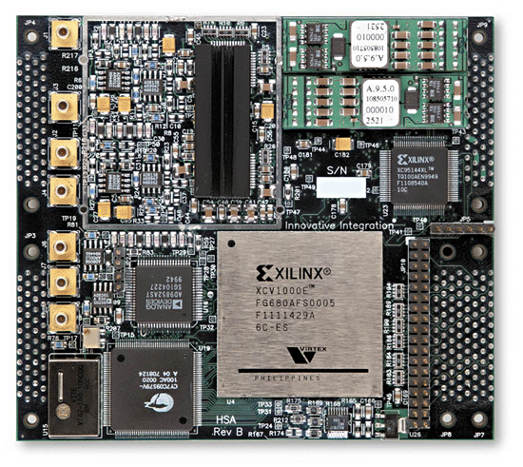
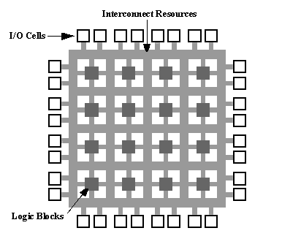
Evolvable Circuits

Slide 82
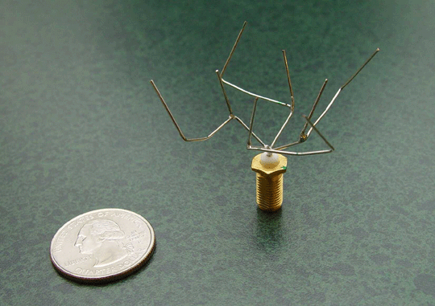
Antenna for NASA
Notes:
http://www.nasa.gov/centers/ames/news/releases/2004/antenna/video.html

Slide 83
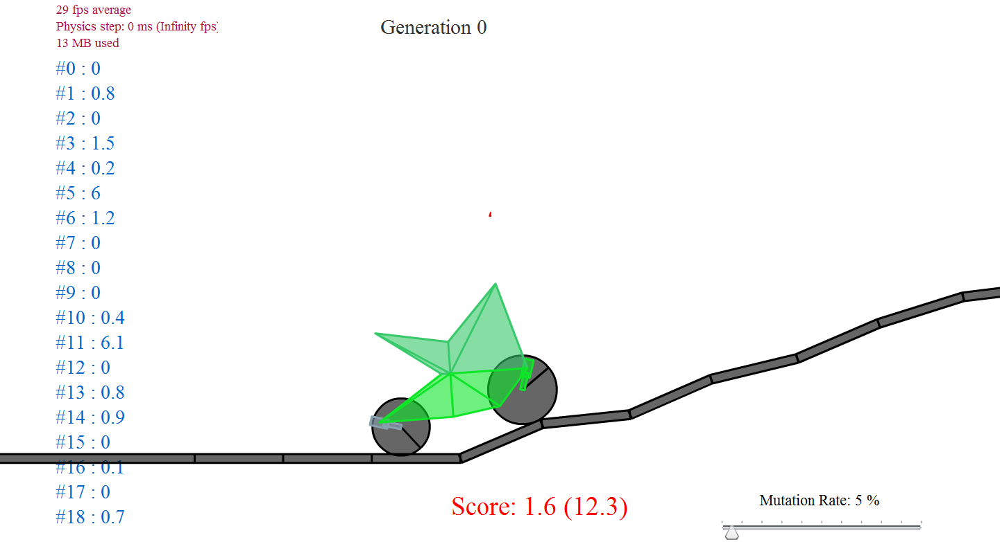

Car Design

Slide 84
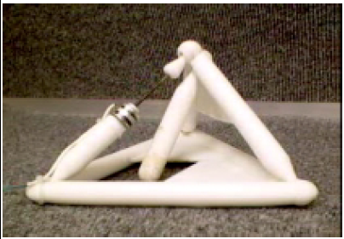
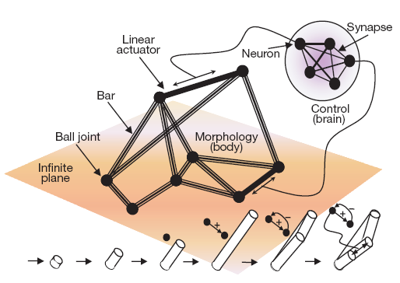
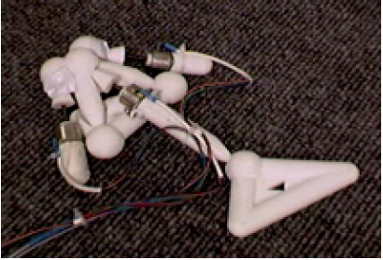
Artificial Life
“Automatic design and manufacture of robotic lifeforms”, Nature 406, 974-978.

Slide 85
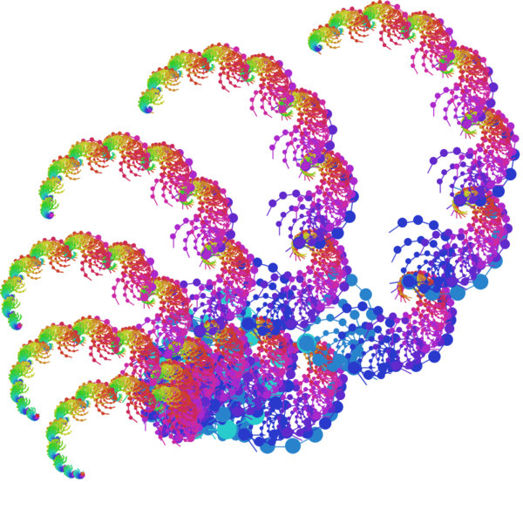

Evolutionary Arts
What is the major challenge?

Slide 86
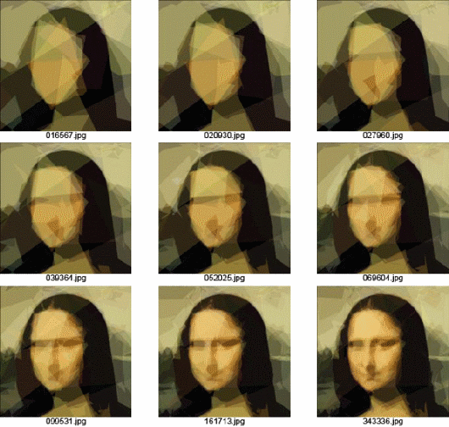
Evolving Mona Lisa
http://alteredqualia.com/visualization/evolve/

Slide 87

There is No Fate But What We Evolve …

Slide 88
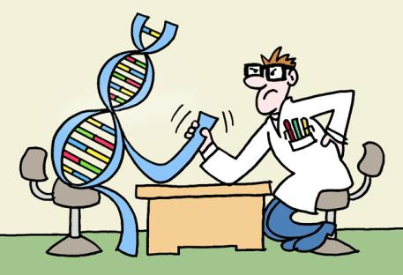
Take Home Message
Evolutionary Algorithms
A group of nature-inspired algorithms
General purpose techniques (Very Powerful!)
Genetic Algorithms can do
Function Optimization
Feature Selection
Classification
Clustering
Genetic Programming can do
Regression
Classification
Intelligent Design

